Slide 1
Image Classification with ConvMixer
Team 4
Zhaoyu Yin
Jiaye Liu
Junyang Li

Slide 2
Motivation
The dominant architecture for vision tasks:
ResNet (2015)
Challenger from Natural Language Processing:
Vision Transformer
Why?
Figure out what makes it so powerful
Can we design a more efficient neural network for image classification?
ConvMixer
Notes:
We all know that the convolutional neural network such as ResNet has been the dominant architecture in computer vision for a few years. However, recent experiments have shown that a challenger from the natural language processing which we learnt in lecture 16, can perform even better than the ResNet in some situations. It is named as vision transformer, which is also a transformer-based model.
If we research further, we should ask why. Why could a player from another field can challenge the ResNet? To answer this question, we should figure out what makes it so powerful.
Then, can we design a more efficient neural network for image classification? The answer is yes. That is the ConvMixer, and we will discuss later.

Slide 3
Goal
Explore the components and the features of the ViT
Is the performance of ViT due to the inherently powerful Transformer architecture or due to using patches as the input representation?
The implementation of the ConvMixer
similar to ViT in many aspects
modify a prototype ViT with new architecture
compare the ConvMixer with the original ViT
Notes:
First, we should understand the components and the features of ViT.
The paper raised a good question.
Is the performance of ViT due to the inherently powerful Transformer architecture or due to using patches as the input representation? We can consider the ViT as the combination of two big ideas. The first is using patches as the input representation. The second is the architecture it uses.
The second goal is the implementation of the ConvMixer. Because of the similarities to ViT in some aspects such as using patches as the input. We can modify the prototype ViT code simply by replacing the architecture with the new network. Meanwhile, we can keep other sections such as hyperparameters, datasets, training, and compiling strategy. Therefore, we can get two different neural networks. The previous question can be reduced to the question that which model is better?

Slide 4
Main Reference Work
Paper 1: Transformer for Image Recognition at Scale
https://arxiv.org/pdf/2010.11929.pdf
Explanation to the Vision Transformer
Paper 2: Patches are all you need?
https://openreview.net/pdf?id=TVHS5Y4dNvM
Explanation to the ConvMixer
Datasets:
Cifar10 with 10 classes (32 x 32) pixels 60000 images
Cifar100 with 100 classes
Notes:
These are the two paper we used. The first explains the vision transformer in details. The second explains the structures of the ConvMixer. We used both cifar10 and cifar100 datasets. Cifar10 has 10 classes and Cifar100 has 100 classes. Each image has 32 * 32 pixels.

Slide 5

Main architecture of the ViT
Three parts
Linear projection of Flatten Patches
Transformer Encoder
MLP Head
Notes:
As we can see, this animation shows how Vision Transformer works. There are three steps. First, the image is divided into many patches. Each patch will be linearly projected. Next comes with the transformer encoder. The last part is the multiple layer perceptron head, which is designed to output the final class.

Slide 6
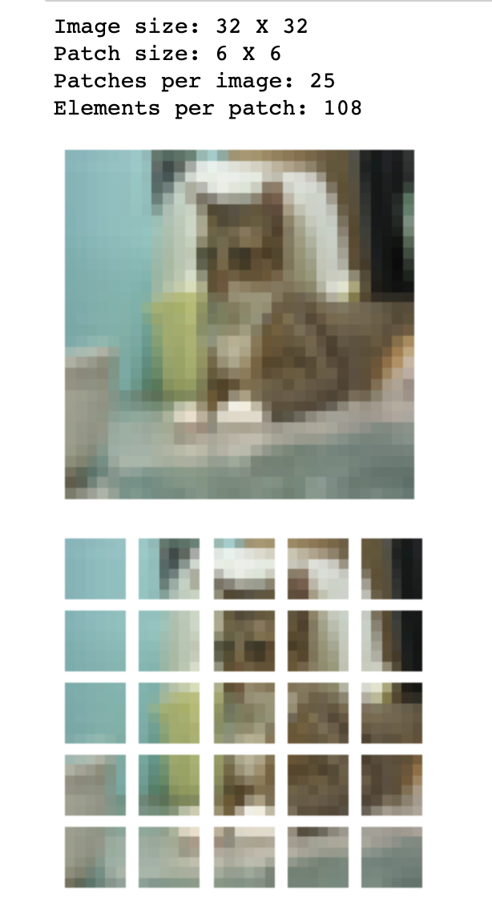
Linear Projection of Flatten Patches
Use a convolutional layer to divide
the image into patches
Linearly map each patch to one-
dimensional vector(token)
concatenated with [class]token
Position Embedding
(Position Encoding in NLP)
Mark the position of a token in the
Sequence
Notes:
Using patches is an important idea in our research. As can be seen here, by using a convolutional layer, the initial image has been divided into several patches. The kernel size and the stride are the same as the patch size. Then, we can map each patch to one-dimensional vector, which is named as token. Also, it is concatenated with another class token for classification. The position embedding is the same as position encoding in the natural language processing. It can mark the position of a token in the sequence.

Slide 7
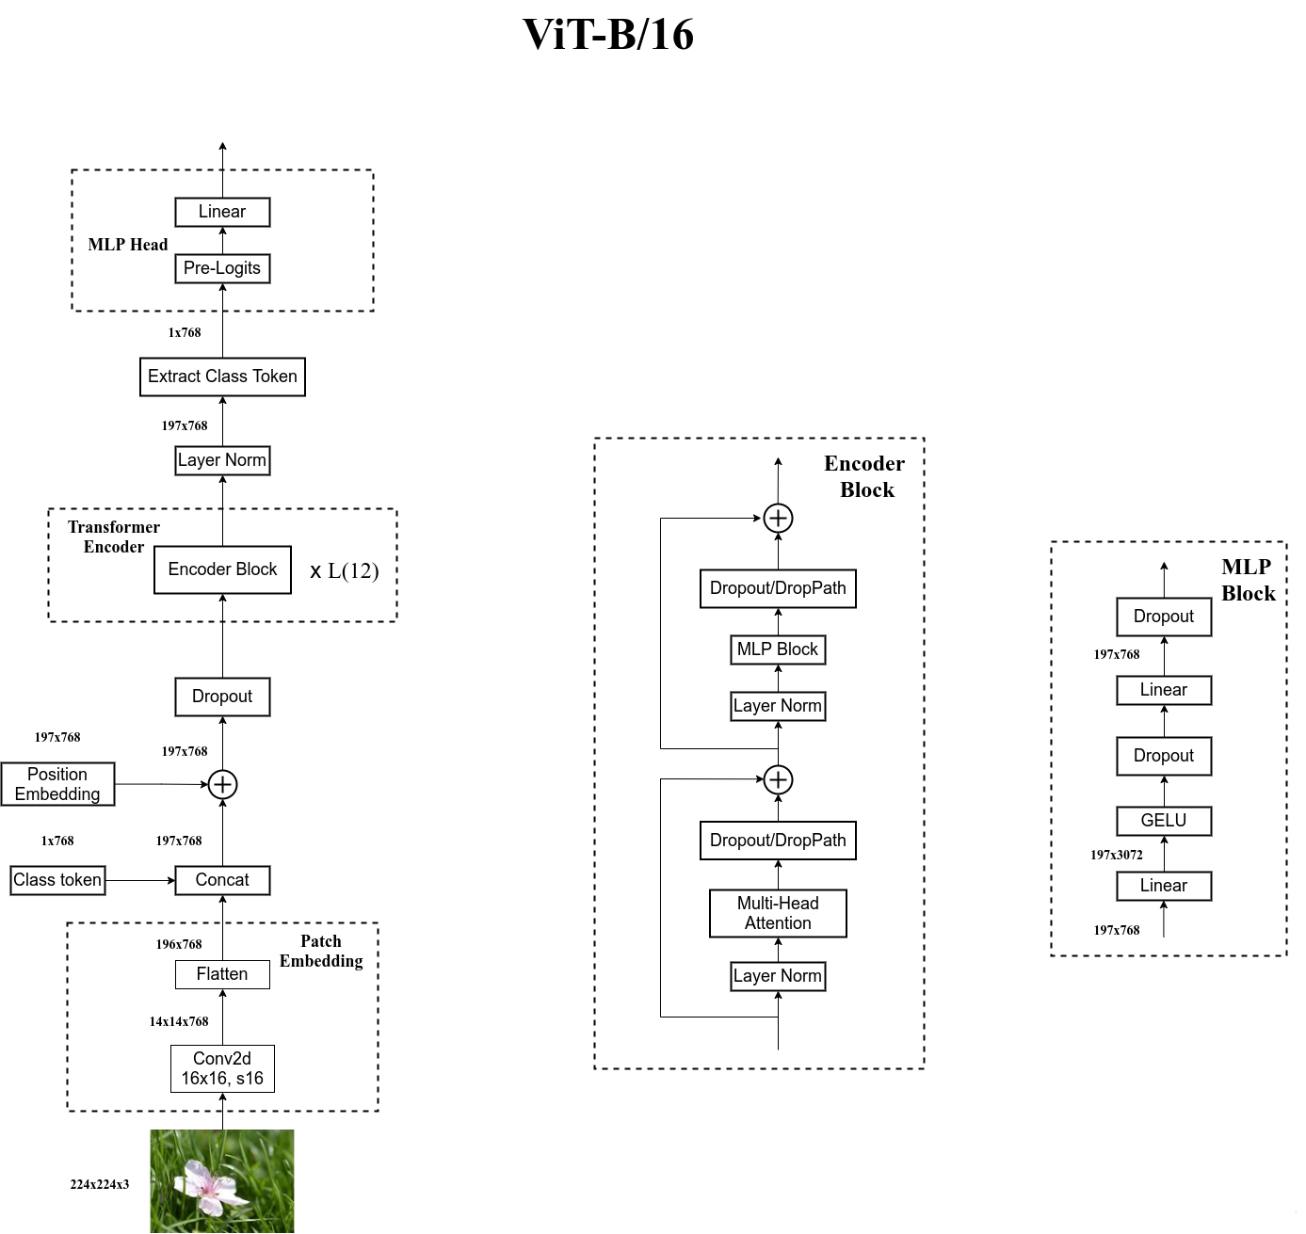
Flow Chart of ViT
Notes:
This is the detailed flow chart of the vision transformer. We just showed the patch embedding. The encoder block iterates for a few times. Here is the detailed structure of the encoder block. Multi-head attention is an important mechanism. It can divide the model into multiple heads to create multiple subspaces so that the model can focus on different aspects of the information. It is great, but the computing cost is expensive. Then, it goes to the MLP block, which consists of multiple layers with dropout and gelu function. We only want to keep the patch embedding and replace other parts with the convolution Mixer network.

Slide 8
Limitations of the ViT
Need pre-trained
Large amount of calculation
the complexity is proportional to the square of tokens num
Need more training data
weaker inductive-bias mechanism
A large number of parameters
more than 50M
Notes:
That design makes the vision transformer extremely powerful. However, there also exist some limitations. We noticed that all results with high accuracy in the paper pre-trained first. For example, some datasets from Google. Also, because of the multi-head attention, the complexity is large, proportional to the square of tokens. According to the paper, the excellent performance of the vision transformer becomes obvious only when using larger dataset. Last, this model uses many parameters. Therefore, the vision transformer is time-consuming. This is also the reason why we did not want to implement this model. Instead, we want to figure out a more efficient neural network.

Slide 9
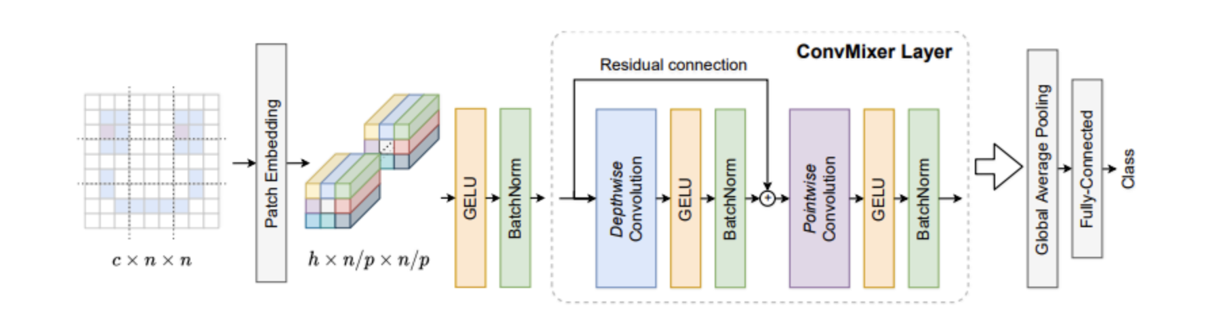
Architecture
Overview of the architecture

Slide 10
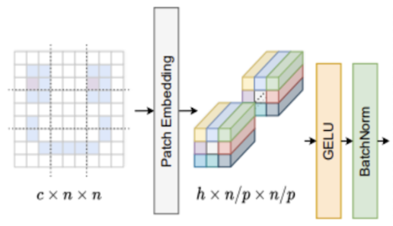
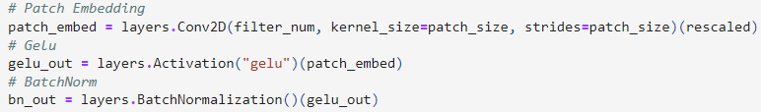
Patch embedding layer
Split the image into multiple patches
Single convolution with kernel size p, stride p, and h output channels, followed by a non-linearity
n * n image to features of shape h * n / p * n / p
GELU + batch norm
Notes:
The first step is to use patch embedding to split the image into multiple patches. Our approach is to use a single convolution with kernel size p, stride p, and h output channels, followed by a non-linearity. which turns a n * n image into features of shape h × n/p × n/p. Each convolution operation is followed by a GELU activation and post-activation batch norm.

Slide 11
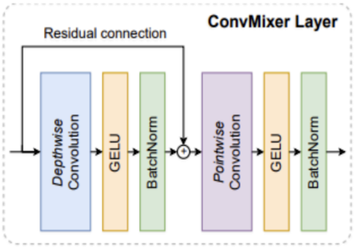
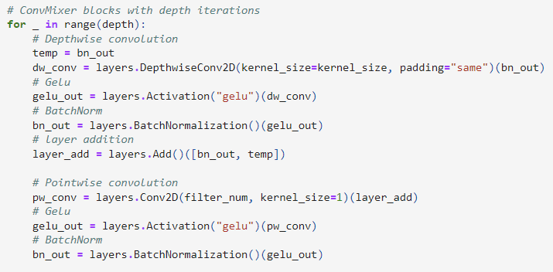
ConvMixer block
Depthwise convolution
Grouped convolution, groups = channel h
Using a skip-connection to perform an addition at the end of the post activation function
Pointwise convolution
Kernel size 1 * 1
Notes:
There are two part that together become the convmixer block. The first part is the depthwise convolution which is a grouped convolution with groups equal to the number of channels h. We use a skip connection to perform an addition between the residual function of previous operation and the layer input. This is then feed into the the second part, a pointwise convolution with kernel size 1*1. This block will loop x times where the x is determined by the depth.

Slide 12
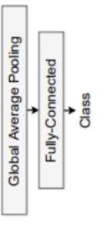
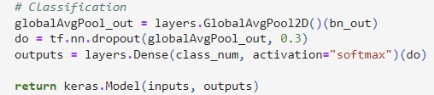
Final Stage
Global average pooling
Flatten the feature into a vector of size h
Dropout
Prevent overfitting
Softmax classifier
Notes:
Finally, we use a global average pooling to flatten the feature into a feature vector of size h, a dropout that prevent overfitting, and lastly we have the softmax classifier to make the inference.

Slide 13
Parameters
The width “h”
The dimension of the patch embeddings
The depth “d”
The number of loops in the ConvMixer layer
The patch size “p”
Determine the kernel size and the strides
Smaller patch size yield better result (more compute-intensive)
The kernel size “k”
Kernel size of the depthwise convolutional layer
Notes:
There are four key parameters of this model.

Slide 14
Architecture Feature
Isotropic architecture
Same resolutions, #channels in every layer
Patches
Diving images into patches and operate on it directly
Convolution
Convolutional layer in ConvMixer block.
Patch embedding stage followed by isotropically repeated convolutional blocks
Notes:
The feature of this architecture is it uses isotropic architecture similar to transformer, which has same resolutions and number of channel in each layer. It also utilize patches inspired by vit(Vision Transformer). Lastly it uses convolutional layer instead of transformer to process the image. In summary, this model has a patch embedding stage followed by isotropically repeated convolutional blocks.

Slide 15
Experimental Setup
Use CIFAR10 and CIFAR100 as datasets
Standard hyperparameters
Validation split = 0.1, with 10000 test set
Data Augmentation

Slide 16
Training Details
Dropout = 0.3
AdamW weight decay with learning rate 0.001 and decay rate 0.0001

Slide 17
Experimental Results
Architects | ViT (cifar10) | ViT (cifar100) | ConvMixer (cifar10) | ConvMixer (cifar100)
Accuracy | 72% | 56% | 82% | 52%

Slide 18
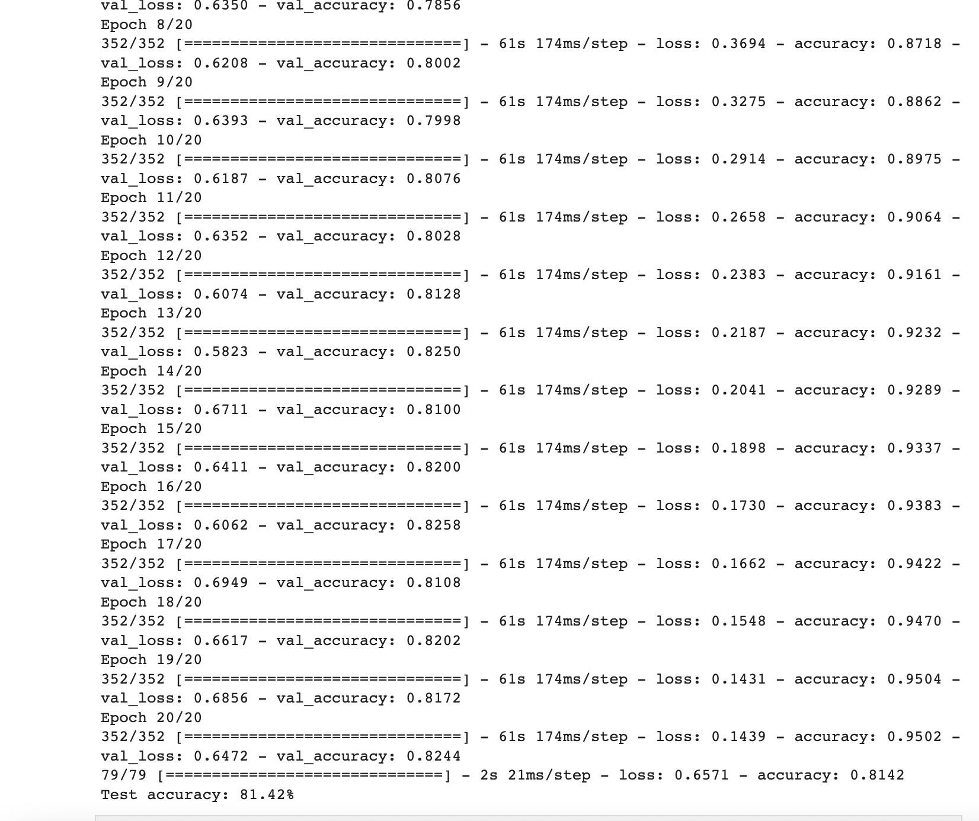
Demos

Slide 19
Conclusion
Q: Is the performance of ViT due to the inherently powerful Transformer architecture or due to using patches as the input representation?
ConvMixer is a simpler model which allows direct operations on patches.
ConvMixer has better performance with similar data sizes and parameter counts.
Experiment on larger datasets to better understand and compare the two models in the future.

Slide 20
Github Link
https://github.com/CS523-Project/Image-Classification

Slide 21
QUESTIONS?
Thank you!

